Slide 1

Predicting Boarding House Price in Jakarta
Created By : Sofian Fadli

Slide 2
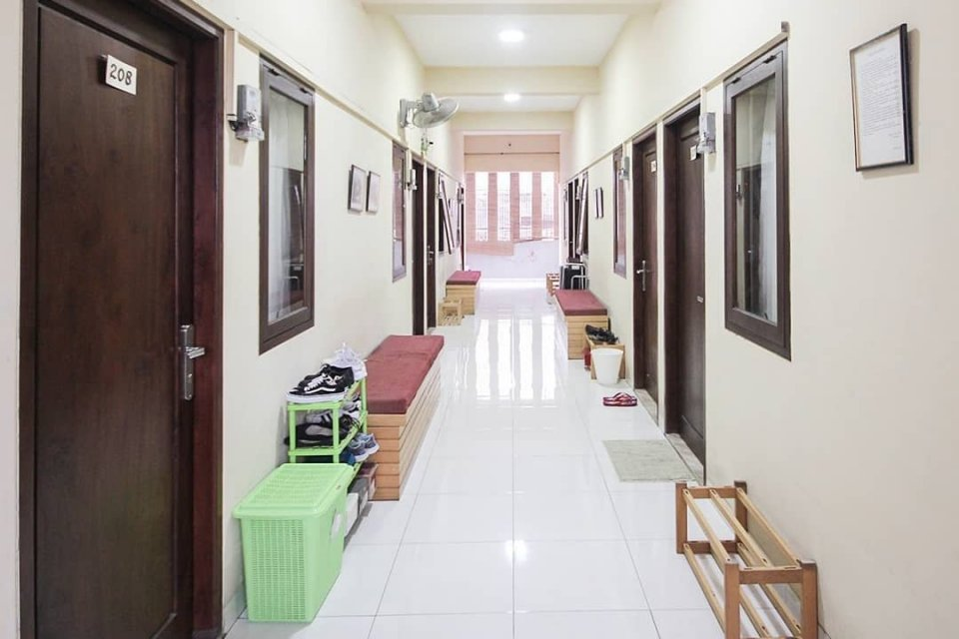
Predicting rent price is valuable for nomads and owner’s boarding house
Boarding prices are determined from the facilities owned by the boarding house.
Getting an appropriate price estimate will help:
- The nomads to estimate the rental costs that they must spend each month
- The owner of the boarding house to get the right price

Slide 3

Data Acquisition and Cleaning
Data obtained from the website https://mamikos.com/, where we limit only boarding houses in Jakarta and have a max price of up to 3 million rupiah. We do scrapping using beautifuloups and selenium.
Initially we have 398 rows and 4 columns. 1 column contains the facilities of each boarding house. Then we select only 6 facilities, and we remove the data outliers, so that the remaining features are 328 rows and 8 columns.

Slide 4
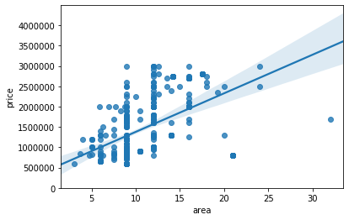

Relationship Between Area Size and Rent Price
We get the area size by multiplying the width and length (in meters).
The Correlation Score is quite high, 0.503 and seen linear relation with price.

Slide 5
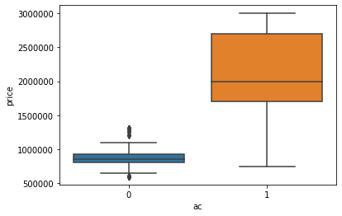
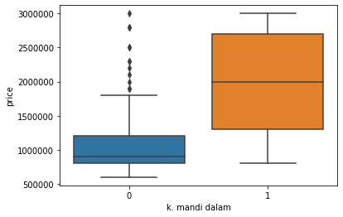
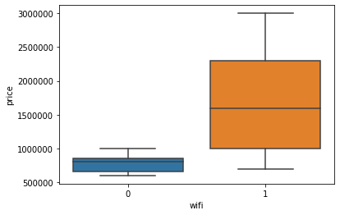
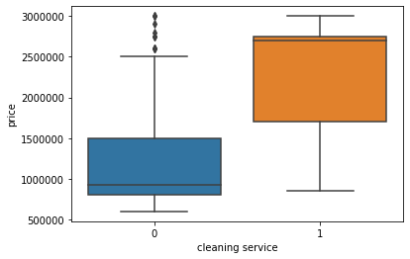
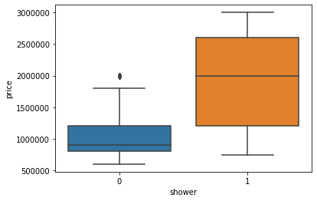
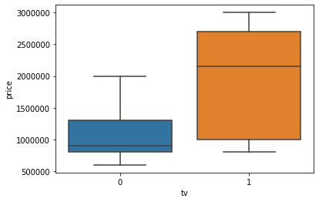
Relationship Between All Choosen Facilities and Rent Price
All the facilities has P < 0.001. We using Pearron Correlation for check correlation.
Corr = 0.804
Corr = 0.66
Corr = 0.510
Corr = 0.553
Corr = 0.581
Corr = 0.580

Slide 6


Relationship Between All Choosen Facilities
So, as we can see, AC facility is the highest parameter which determine the rent price. Second is Indoor Bathroom, etc.
AC > Indoor Bathroom > Shower > TV > Cleaning Service > WiFi

Slide 7
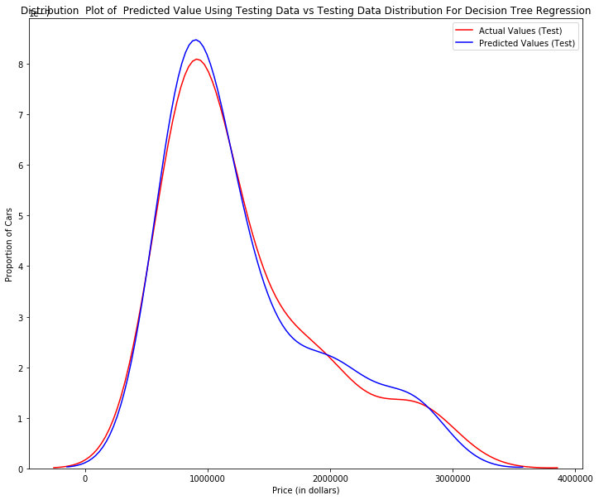
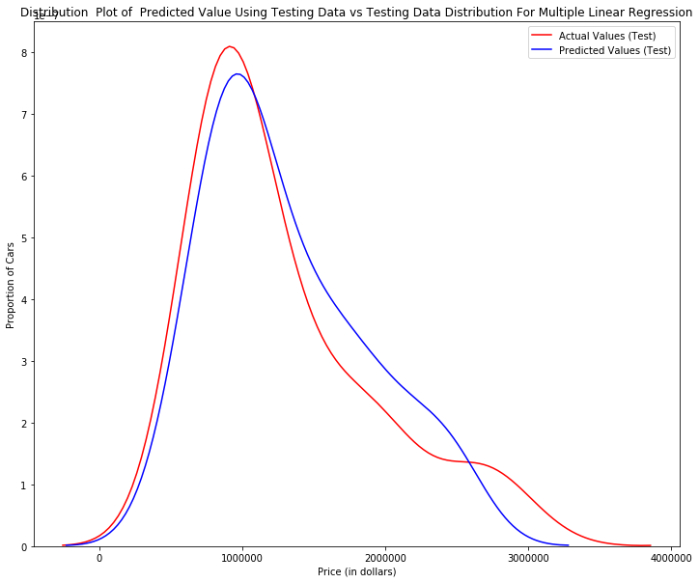
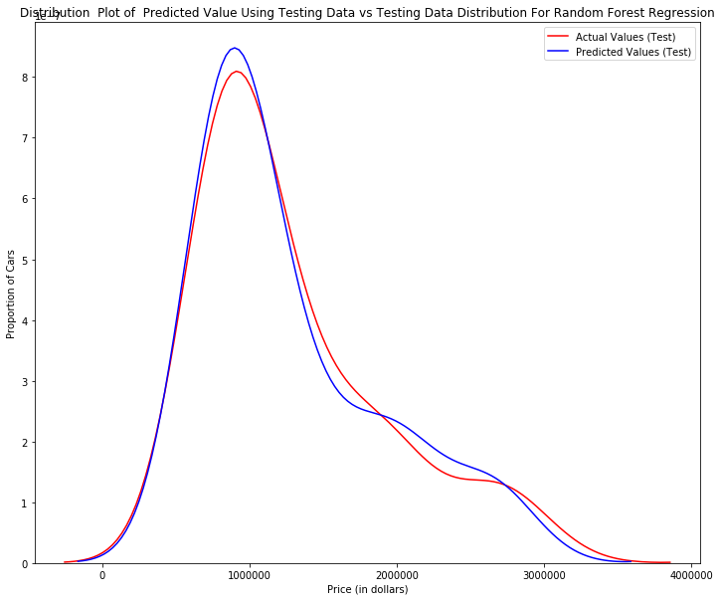
Plot Distribution test price VS price predictions
Random Forest Regression
Multiple Linear Regression
Decision Tree Regression
As we can see there is no overfitting or underfitting.

Slide 8
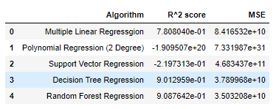
Regression Model
I use 5 algorithms to do regression modeling, namely multiple linear regression, polynomial regression, SVR, decision tree, and random forest. But what is good for modeling this data is only 3, namely multiple linear regression, decision tree, and random forest. For Random Forest, R^2 score is quite high, which is 0.908. Then followed by the decision tree, which is 0.901. Finally by multiple linear regression, which is 0.78.

Slide 9

Future Directions
Here, I only retrieve boarding house data based on boarding facilities and the rental price. While in Jakarta, the location can also greatly affect the price of boarding rental. For example, boarding houses that are close to the office usually have a higher rental price. Usually, location information is very helpful in predicting more accurate boarding prices.

